Slide 1
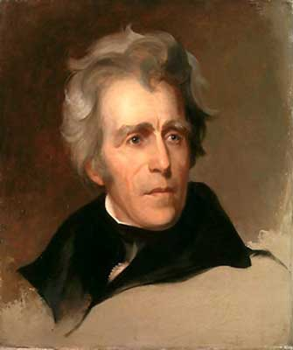
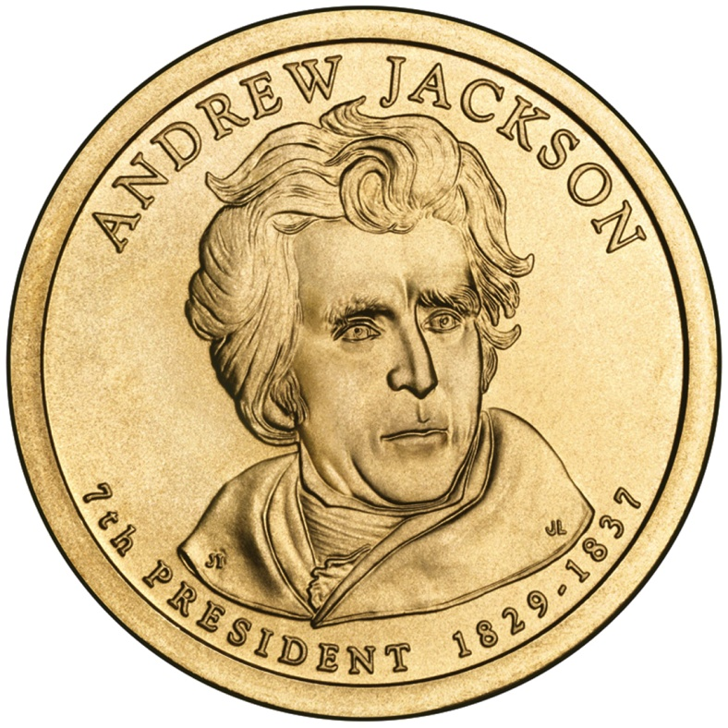
The Jackson Era
A New Era in Politics
AIM: What political & social changes did the United States witness in the 1820s?

Slide 2
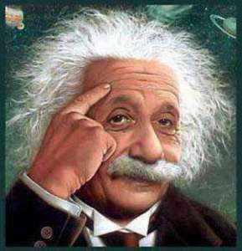
Terms to Know
Suffrage – the right to vote.
Majority – more than half.
Caucus – private meeting often political.
Nominating Convention – where delegates from all the states choose the party’s candidate for President.
Mudslinging – the use of insults
to attack an opponent’s
reputation.

Slide 3
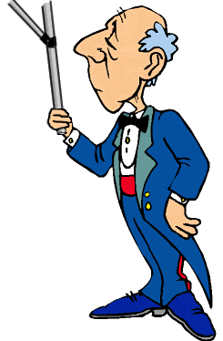
Growing Spirit of Equality
The Spirit of Democracy, which was changing the political system, affected American ideas about social classes.
Americans felt that the wealthy did not deserve special respect.
European visitors were surprised
that American servants
expected to be treated as equals.
Get it yourself chap!

Slide 4
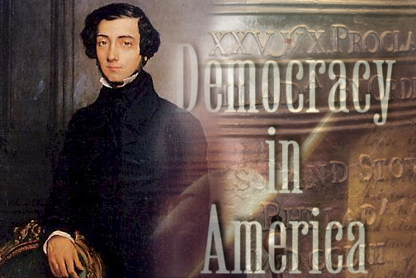
Growing Spirit of Equality
Alexis de Tocqueville
Visitor from France
Well known for his
observations on
American Democracy
Arrived in U.S. in 1831
Documented his observations in his book Democracy in America.
Book admired the American democratic spirit & its goals of equality & freedom.

Slide 5
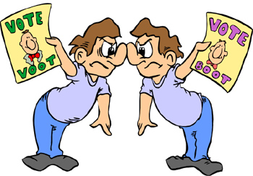
More Voters
During the 1820s, more people gained suffrage, or the right to vote; mainly white males over the age of 21.
Exercising their right to vote:
Before 1828 – Not more than 27% voted
Election of 1828 – 58% voted
By 1840 – 80 % voted
Limits on Suffrage: (These groups did not have the right to vote...yet.)
Women
Native Americans
African Americans
Slaves

Slide 6
Suffrage Expands
Growing Spirit of Equality
- The spoils system lets ordinary citizens participate in government
- Ideas about social classes change.
- More white men eligible to vote.
- Property qualifications for voters end.
- Voter turnout is 80% in 1840.
- The caucus system ends.
- Nominating conventions are held to choose presidential candidates.
The “Common Man” Rises
Political Parties Change

Slide 7
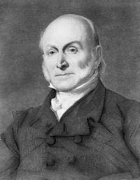
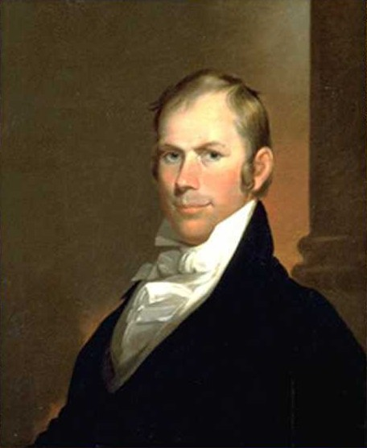
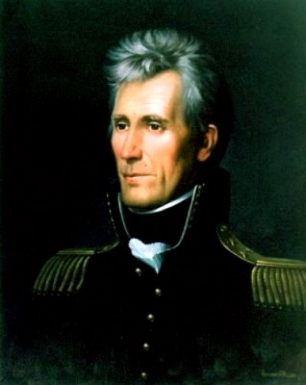
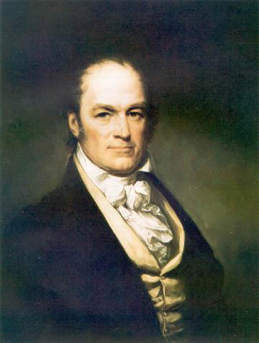
Disputed Election of 1824
Four Candidates
John Quincy Adams (New England)
Henry Clay (The West)
Andrew Jackson (The West)
William Crawford (The South)

Slide 8
Disputed Election of 1824
“The Corrupt Bargain”
No clear winner
Jackson won popular vote
No candidate won majority of electoral vote
House of Representatives must choose from top (3) candidates
Henry Clay finished 4th so he was out, but he was Speaker of the House
Clay influences the House of Reps to vote for Adams
Adams wins & makes Clay Secretary of State
Jackson was furious & accused Adams & Clay of making a “corrupt bargain”.

Slide 9
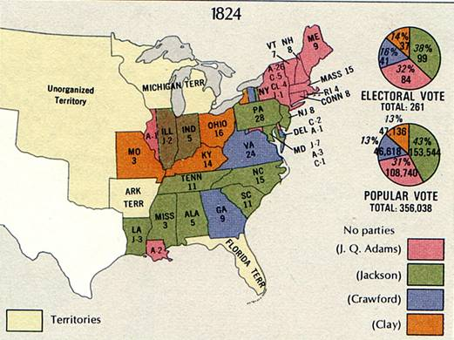

Slide 10
John Quincy Adams
6th President but not so popular.
Thought federal government should promote economic growth.
Called for new roads & canals to help farmers.
Most Americans objected to spending for fear it would lead to an all powerful federal government.

Slide 11
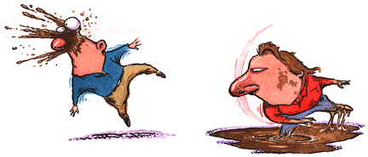
Election of 1828
Due to Adams increased gov. spending & unpopularity, Andrew Jackson won the election easily, becoming 7th president.
Campaign featured mudslinging.
Adams cared only for upper class
Jackson compared to Napoleon
Jackson supporters cheered the outcome as a victory for the common people.
Farmers in the West & South
City workers in East

Slide 12
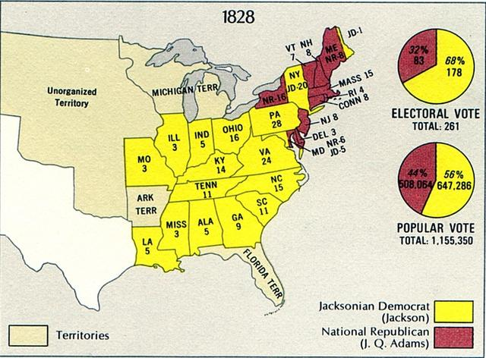

Slide 13
Jacksonian Democracy
Jackson’s inauguration in 1829 reflected the growing spirit of democracy.
The spread of political power to more people was part of what became known as Jacksonian Democracy.
Jackson was the first westerner to occupy the White House. Election represented a shift in power to the West.

Slide 14
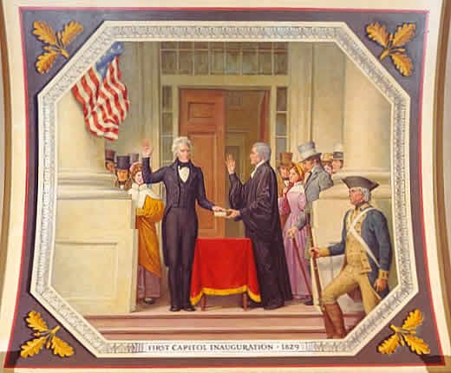
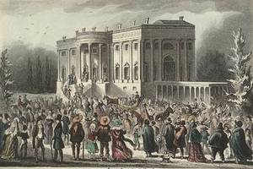
Inauguration Day
1st time thousands of ordinary people flood Capital to watch President take oath of office.
Crowd so huge President was almost suffocated by people trying to shake his hand.

Slide 15
New Political Parties
In the 1830s, new political parties emerged.
Whigs – wanted federal government to help the economy. Included business men, southern planters, and former Federalists.
Democrats – supporters of Jackson. Included frontier farmers and city workers.
Not these wigs, Whigs.

Slide 16
New Ways to Choose Candidates
The two new political parties developed more democratic ways to choose candidates for President.
In the past, members of parties held a caucus.
What is a Caucus?
In the 1830s, each party began to hold a nominating convention.
What is a nominating convention?

